Slide 1

DBS Bank
Client’s Logo
Health Report Report
VMware Tanzu Labs, APJ
15th September 2022

Slide 2
Health Check Methodology
What did we do?
When & Where: Remotely , 5th September-16th September 2022
Who:
Shivendra Pratap Choubey, Platform Lead, DBS.
Jeffrey Wang, Solutions Architect, Tanzu Labs, VMware.
What:
Prep work: Gathered background information and architectural detail from the Platform and App teams
Interacted with Platform operations team to understand current state of the platform.
Reviewed the disaster recovery plans with the platform team
Conducted interviews with platform team, apps team, DevOps team and product owner and detailed assessment of people, process, technology, and platform architecture and mapped against VMware Pivotal Labs best practices.
Ending with a review of goals, accomplishments, path forward, and overview of recommendations.
Why:
By exploring current teams, processes and technology, the VMware’s Platform Health Check team was able to understand and then recommend best practices.

Slide 3
DBS Platform Health Check - Executive Summary
DBS’s Platform Health Check service was triggered by two severe cases in August. Although through joint efforts of both DBS platform team and VMWare BAT team, the root cause was finally pinpointed and attributed to app side, VMWare’s initiative was to conduct a comprehensive and deep health check aimed to inspect whether there exists potential risks, and if any, to give recommended solution.
Given a previous check was conducted in Oct. 2020, for common practices of the checklist, this engagement was just reviewing the improvement based on previous report. We put more emphasis on capacity planning, apps scaling, testing process and observability which had major influence on app robusticity and performance.
As part of this engagement, some pain points for daily operation and requirements for foundation planning were brought up. Some of the follow-on recommendations outlined in this document will involve additional planning, stakeholders support and can be evaluated and implemented in production environment based on identified priority.
.

Slide 4



A 360 Degree Assessment Of DBS Platform Health
People, Process, Technology
PEOPLE
How is your Platform Team doing? Do they have the right mix of skills? Is there a balance of skillset on the team? Are they empowered? Do they have executive support?
PROCESS
Can your developers self-service their way to experimentation? How do teams get their apps to Production? Are app teams empowered to define their own production release process?
PRODUCT + TECHNOLOGY
Is your Platform a Product? Is it in Production? Are you automating away toil? Are you up to date? Is it reliable? Do developers have the services needed to build apps?

Slide 5
DBS Platform Health Markers
Assessment Dimensions
Monitoring and Metrics
Establishing desired service behavior, measuring how the service is actually behaving, and correcting discrepancies. Examples: response latency, error or unanswered query rate, peak utilization of resources.
Performance Optimization
Characterizing and tracking service component performance, efficiency, and resource utilization, to identify and address regressions, and for driving improvements in efficiency.
TECHNOLOGY
PROCESS
Capacity Planning
Projecting future demand and ensuring that a service has enough capacity in appropriate locations to satisfy that demand. Examples: cells, routers, datastores, network, etc.
Business Continuity
The platform team have a plan for business continuity that is frequently demonstrated to meet service level, recovery time, and recovery point objectives.
TECHNOLOGY
PROCESS
Platform Update Engine
Altering the behavior of a service while preserving desired service behavior. Examples: canarying, 1% experiments, rolling upgrades, quick-fail rollbacks, quarterly error budgets.
Platform as a Product
The platform’s capabilities change in response to the needs of its users. It is treated as a product that is inclusive of not only PCF but all the services and integrations that make it a viable environment for applications to run.
TECHNOLOGY
PROCESS
Emergency Response
Noticing and responding effectively to service failures in order to preserve the service's conformance to SLA. Examples: on-call rotations, dip detection, escalation, playbooks, wheel of misfortune.
Balanced Team
The platform team consists of a product manager and at least two platform engineers with a combination of infrastructure and software engineering skills.
PROCESS
PEOPLE
Self Service
Instantiating and deleting service capacity in a predictable fashion, often as a consequence of capacity planning. Examples: organizations, spaces, apps, marketplace service instances, etc.
Path to Production
Developers are able to take full advantage of the platform via modern and optimized tools and processes.
TECHNOLOGY
TECHNOLOGY

Slide 6
Major Findings & Recommendations
Key themes and opportunities for platform improvement

Slide 7
Capacity Planning--Scaling Based on CPU Utilization
Facts:
Entitled CPU of AIs is based on the CPU shares assigned to an app which is based on its memory limit.[link]
Applications’ CPU entitlements are guaranteed minimums.[link]
Application can burst and consum spare CPU cycle.
CPU usage of cf app [app] is a percentage of cell host CPU, not a percentage of its entitlement.
A constantly-high CPU apps could disadvantage other apps on the same cell to slow, performing poorly, experiencing high latency. [link1] [link2]
PCF Autoscaler may not reliably scale apps when using scaling rules based on CPU utilization.[link]
Recommendations:
Try to run the CPU entitlements cf cli plugin against the app while the app is under load.[link]
Decide to scale the app based on avg cpu usage metric from cf cpu app output.[link]
Prefer autoscaling apps based on http related metrics--http latency and throughput. [link1][link2]
Increase CPU shares i.e. increase the memory limit for apps under load.[link]
Alternative for CPU entitlements cf cli plugin, check container metrics “AbsoluteCPUEntitlement”, ”AbsoluteCPUUsage” for AI cpu usage. [link]

Slide 8
Capacity Planning--Scaling Diego Cell
Recommandation:
General guide for TAS components scaling is based on key capacity scaling indicators.[link]
Diego Cell CPU to VM ratio is very important.(Based on AI specs, #AI per diego cell)
ORG/SPACE Quotas
--How much have you allocated?
--Does your committed Diego Cell memory capacity match that quota allocation?
Consider reserve resource for diego cell drain and AI evacuation.
This is a capacity planning sheet for reference. [link]
And a video for details. [link]

Slide 9


Capacity Planning--Big Foundation or Multi-Foundation
Key questions of scaling:
How big is too big
for a single foundation?
How many foundations is too many
Vertical
Horizontal

Slide 10
Capacity Planning--Big Foundation or Multi-Foundation
Big foundation potential issues:
Network configuration considerations.[link]
Slow upgrades, including platform upgrading, repaving stemcell, certs rotation and ODS upgrading.
Network jitter and congestion due to high traffic.
CAPI latency due to large requests, e.g. log and metrics which need map guid,say app guid, to readable name.
Huge log stream incurs considerable log loss, even scaled doppler and ltc to maximum recommended.
Multi-foundation considerations:
Pipeline all the foundation with Platform Automation
Concourse installation for each foundation
Diff configs between to ensure conformity.
CI/CD for No-OpsMan configuration.
Cross-DC Active/active foundation design
A comprehensive routing design based on foundation location.

Slide 11
Capacity Planning--Big Foundation or Multi-Foundation
Recommendations:
Diego cell count of single foundation is not going over 250.
Multi-foundation provides better isolation level.
Multi-foundation for CC latency (sometime, backend ccdb is one of the bottlenecks of CAPI performance).
Multi-foundation for high log loss rate--with maximum recommended configuration.
SLO for Apply change operation.
Available upgrading window for PCF.

Slide 12
Platform as a Product--Optimize Testing Process
Observed:
Some app issues arose in Prod env while didn’t in UAT env.
Recommendations:
Do a comprehensive testing totally simulating the real scenarios of Prod env in UAT env.
Conduct behavior testing with such tools as Selenium to test the workflow in UAT env.
Do a load testing for each app with designed peak traffic and through rush hour in UAT env.
Do regress testing for each change.

Slide 13
Path to Production--Enablement Workshop with Balanced Team
Observed:
Enablement needed for platform features and cloud native principle .
Recommendations:
Enable app team to have a deep understanding of platform functionality and features.
Workshop with app team on cloud native development and practices of splitting monolith to microservices
Answers for some questions during the interview.
Scale an app:
--Use cf cli. [link]
--Use apps manager autoscaler. [link]
--Use cf cli Create and Bind the App Autoscaler Service. [link]
Rollback to previous deployment. [link]
Restage with zero downtime(). [link]

Slide 14
Business Continuity--Migrate WebDav to External Blob Storage
Improving Efficiency & Reliability:
Using internal blobstore == NFS running on VM.
Decrease platform upgrade times while increasing availability.
-- NFS VM is not HA (single point of failure)
-- Large NFS persistent disks leads to long upgrade times
-- Long upgrade times lead to dev outages and potential issues with auto scaling/healing
Decrease backup time and reduce outage(cloud controller[CC] lock).
CC response time(sometime, backend ccdb is one of the bottlenecks of CAPI performance).
-- Locked CC leads to dev outages(no app pushes, no delete, no autoscale)
-- Possible to do more backups to meet or increase Recovery Point Objectives(RPO)

Slide 15
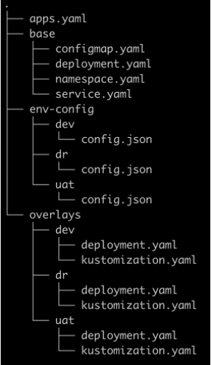
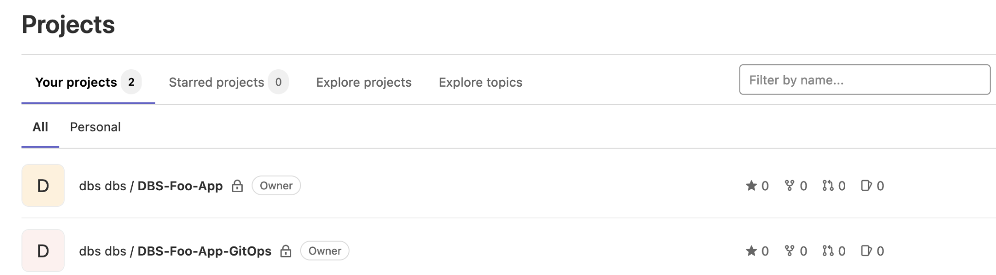
Platform as a Product--Optimize DevOps Practice
Observed:
Shared repository for both source code and deployment manifest(configuration files).
-- Fresh building required for each deployment.
-- Pull request/merge required for each environment promotion
There exists plaintext secret/password in repository
Recommendations:
Separate configuration(deployment) repository from source code repository.[link]
-- Separate developer concerns from operational maintenance and security.
Use such tools as Hashicorp vault or credhub to manage secrets
Use individual file or directory to manage various tenancy (in a GitOps way).[link]
-- Easy to prompt
-- Easy to add extra deployment env, such as hotfix.

Slide 16
Business Continuity--Http Health Check for Applications
GTM
Recommendations:
Configure BIG-IP DNS HTTP health monitor.[link]
Apps expose health check endpoint /healthz
--Just response “200 OK”
For existed apps or a series of apps, consider using app-sentinel as a sidecar for health check.[link]
Or GTM probes apps directory as long as apps response “200 OK”
fooapp.dc1.dbs.com/healthz
fooapp.dc2.dbs.com/healthz
LTM
LTM
FooApp
/healthz
FooApp
/healthz
app-sentinel
app-sentinel
DC1
DC2

Slide 17
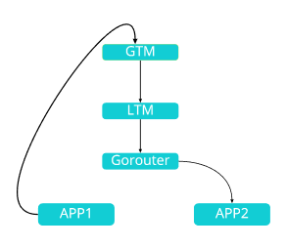
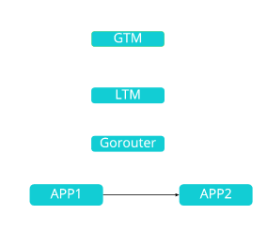
Performance Optimization--C2C Network
uMs inter-invocation
Observed
Benefits:
Short-circuit the round trip and reduce the latency.
Avoid the negative impact of any component failure on the traffic path.
**In TAS for VMs v2.13.0, developers can enable TLS for communication between app containers.[link]
Recommended

Slide 18
DBS Platform Health Check
Detailed Assessment

Slide 19
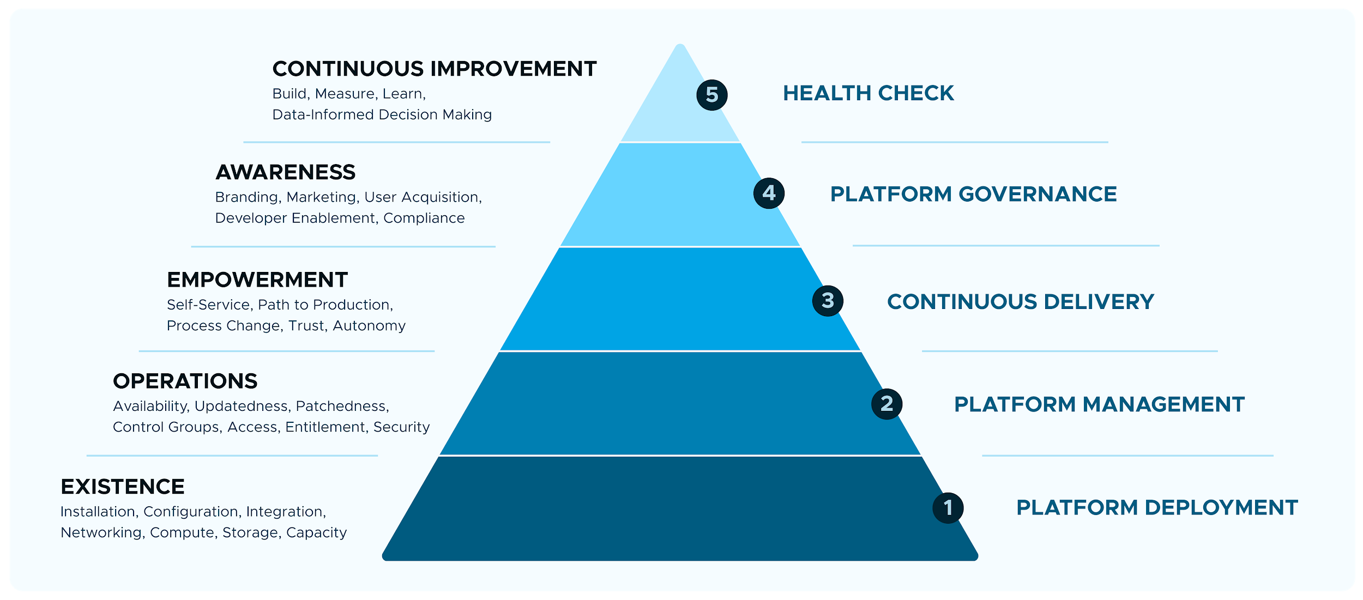
The path to a high performance Platform Team is well understood...
Notes:
Once you’ve allocated the right individuals to the team, how do you ensure that they are successful?
We believe that the needs of a Platform Team motivates the behaviors of the people on that team, and success depends on whether you are able to satisfy these needs.
In this model, a Platform Team has a hierarchy of overlapping needs. The lower, more fundamental levels of the hierarchy are focused on getting the tools and technology right. As you progress further up the hierarchy, the needs become less about technology and more about people and process. A key takeaway is that these needs are continuously overlapping, so you don’t need to satisfy one level fully before progressing, but lower levels may take precedence over other levels at any point in time if not sufficiently addressed.
It all starts with existence. When you get started in your journey, you want to secure the networking, compute, and storage capacity required for the installation, configuration, and integration of your platform. Leveraging our Platform greatly accelerates these activities, as you don’t need to build the vast majority of your platform features; they are already built.
In today’s technology landscape, a platform starts to fall out of date as soon as its installed. Your platform team will need to provide a platform that is available, patched against vulnerabilities, and kept up to date in order to protect the business while attracting developers and their workloads. Operations is a perpetual activity.
Once you’ve satisfied existence and operations, you’ll have a stable foundation for workloads to land on. In order to acquire these workloads, you’ll need to talk with users to make sure you are building the features they need - the reusable building blocks that will accelerate them. In other words, you must adopt a product mindset. You’ll need to engage with Governance Teams to make sure you’re delivering these features in a way that minimizes risk to the business. At this level, the team is building a funnel of users and branding and marketing their platform product to those users. A strong product manager is a necessary component of a high performing team at this level.
You’ll know you’re succeeding this far if your user base is continuing to grow. As you expand your footprint and provide the platform to more developers you’ll want to maximize their productivity by empowering them to innovate. You can do this by fostering a culture of trust and autonomy, providing self-service access to the platform and its features, and helping to optimize their path to production.
Continuous improvement is fundamental to this model, and it ensures that your capability continues to get better rather than atrophying

Slide 20
What did we find?
People

Slide 21

Definition:
Platform team consists of dedicated product management and engineering roles who are empowered to make strategic and implementation decisions autonomously.
Balanced Team
Chaotic
Defined
Managed
Measured
Continuous
Observations and Actions:
Platform Ops Team:
Each team member in Platform Ops team is aware of their roles and responsibilities.
Team have a collective understanding and visibility of the platform backlogs.
Team is highly regarded for their responsiveness, collaboration and support by the development teams
Team have individual expertise in certain areas which causes individual dependency.
Team have shown maturity.
Platform Ops team is spending reasonable amount of time helping developer queries.
Development Team:
An enablement workshop is necessary for dev team to get better understanding of platform features .
An AppTx workshop is necessary for dev team to get more cloud native development practices.
All team members should attend the regular knowledge sharing meeting.

Slide 22
What did we find?
Process

Slide 23

Definition:
Treating the platform like a product that evolves over time to meet the needs of end users. This is accomplished by applying a combination of Lean, User Centered Design and XP practices.
Platform as a Product
Chaotic
Defined
Managed
Measured
Continuous
Observations and actions:
Platform is treated as a product by end users and Platform Ops team.
User Onboarding process is defined.
Platform Ops team is highly appreciated by end customer for their support.
Currently only stateless applications are onboarded to the platform.
Require guidelines for stateful/persistent applications and batch jobs.
CI/CD process is well established
Platform upgrade and install has been automated using concourse pipelines.

Slide 24
Definition:
Noticing and responding effectively to service failures in order to preserve the service's conformance to SLA. Examples: on-call rotations, dip detection, primary/secondary/escalation, playbooks.
Emergency Response
Chaotic
Defined
Managed
Measured
Continuous
Observations and actions:
SLAs are identified and monitored.
Adequate monitoring and alerts have been put in place.
In case of any issue, teams are notified in time.
Emergency response process have been well defined.
Weekend support is available during weekend during APJ hours.

Slide 25
Definition:
Treat the platform like critical infrastructure with published RPO/RTOs that satisfy business requirements. Proving viability of disaster recovery plans by restoring platforms to a known good state through the use of automation.
Business Continuity
Chaotic
Defined
Managed
Measured
Continuous
Observations and actions:
Two foundations in two DCs are deployed in active active mode for production.
Failover is automatic.
Failover mechanism is tested in live production.
Platform backups are taken using automated pipelines regularly.
Restore from backups have not been tested yet.
No downtime faced with platform.

Slide 26
Definition:
Characterizing and tracking service component performance, efficiency, and resource utilization, to identify and address regressions, and for driving improvements in efficiency
Performance Optimization
Chaotic
Defined
Managed
Measured
Continuous
Observations and actions:
Performance benchmark have been defined at application layer.
Grafana dashboards are used for monitoring performance.
Load testing is performed at application level.
From platform perspective disk, CPU and memory is being monitored.

Slide 27
What did we find?
Technology

Slide 28

Definition:
Establishing desired service behavior, measuring how the service is actually behaving, and correcting discrepancies. Examples: response latency, error or unanswered query rate, peak utilization of resources
Monitoring & Metrics
Chaotic
Defined
Managed
Measured
Continuous
Observations and actions:
Currently Healthwatch2, App dynamics , App metrics are used for monitoring.
SLOs are defined and monitored.
Required dashboards are available for monitoring key metrics.
SLA have been identified and monitored
Need improvement in product’s monitoring and metrics.
Developers know how to get the required metrics.
There exists log loss and action should be taken to lower the loss rate.
--Increase the number of doppler and LTC.
--Increase the VM resource of dopper and LTC.
Consider utilizing additional complimentary metrics systems such as Wavefront.

Slide 29
Definition:
Projecting future demand and ensuring that a service has enough capacity in appropriate locations to satisfy that demand. Examples: quarterly projections
Capacity Planning
Chaotic
Defined
Managed
Measured
Continuous
Observations:
Capacity planning is done based on historical trends.
Standard 4 GB memory is allocated to each AI
Isolation segments are used for compute and network isolation.

Slide 30
Definition:
Fast, frequent, frictionless delivery and measurement of incremental platform capabilities in production. Examples: Use of error budgets, vulnerability budget, & legacy budget to govern the rate of change to the platform.
Platform Update Engine
Chaotic
Defined
Managed
Measured
Continuous
Observations:
Platform is upgraded frequently using automated pipelines.
No manual steps required.
Platform update process is well defined.
Platform updates are informed to users well in advance.
Stemcells and buildpacks are continuously upgraded and platform team takes ownership of buildpacks.
The upgrades do not cause any downtime.
No major outages reported during upgrades.
The TAS upgrade planner is leveraged to check for compatibility and to produce upgrade plans.

Slide 31
Definition:
Updates to the platform and to application workloads running on the platform are unencumbered by legacy governance. Release process incorporates cloud native architecture, tooling and practices.
Path to Production
Chaotic
Defined
Managed
Measured
Continuous
Observations:
Platform Path to Prod:
Well defined process.
Test environments are available for testing. Changes are tested in test environment before pushing to production.
Upgrades and patching are done using automated pipelines.
Upgrades are planned in advance.
Application Path to Prod:
Well defined process.
CI/CD tooling is well integrated.
Automated process for deployment in test environment and then promotion to prod is automated.
Application rollback or redeployment is automated.
Application teams confident of deploying multiple releases to production on same day.

Slide 32
Definition:
Getting tenancy on PaaS / CaaS / FaaS deployments, instantiating and deleting service capacity in a predictable fashion, without the need for ceremony. Examples: getting access to PAS, getting a PKS cluster, service instance creation, breadth of service / service plan availability in the service catalog.
Self-Service
Chaotic
Defined
Managed
Measured
Continuous
Observations:
Confluence pages are available for self help topics.
Platform team communicates frequently via distribution lists, yammer, Teams channels to the end users.
Different channels are created for helping end users.
End users can reach out to the Platform Ops team using teams, or via email.
There is a need of self service portal to automate routine tasks like onboarding, user creation, access etc to free up Platform Ops team to focus on other critical tasks.
Developers are aware of self help links.

Slide 33
Platform Health Check
Outcome-based Roadmap

Slide 34
Outcome-based Roadmap
Why?
Helps everyone understand why we are building the product
Creates alignment between stakeholders, sponsors and the product team
States what impact we hope to have by creating the product
Helps us prioritize and plan based on value
Empowers the product team to solve problems rather than implement solutions
Enables us to learn and adjust

Slide 35
Outcome-based Roadmap
How do I prioritize?
User Voice:
Gather feedback from end users (platform engineers, app developers, operations, etc). Understand the real value of every request.
Value vs. cost:
Perform a cost-benefit analysis to figure out which initiatives are worth working on. Ensure the enhancements are strategically-sound .
Review & share:
Share your roadmap. Review with all the stakeholders, get their buy-in and alignment.
Iterate and re-prioritize every quarter.
High
Quick Wins
Strategic Wins
Business Value
Nice to haves
Deprioritize
Low
Cost
High

